Slide 1


Slide 2
Index
Main Idea: Which areas experience more activity-rural/metropolitan
Question….Where
Step 1 data Prep
Step 2 Analysis
Step 3 Results Statistical Findings
Conclusion
Q&A

Slide 3
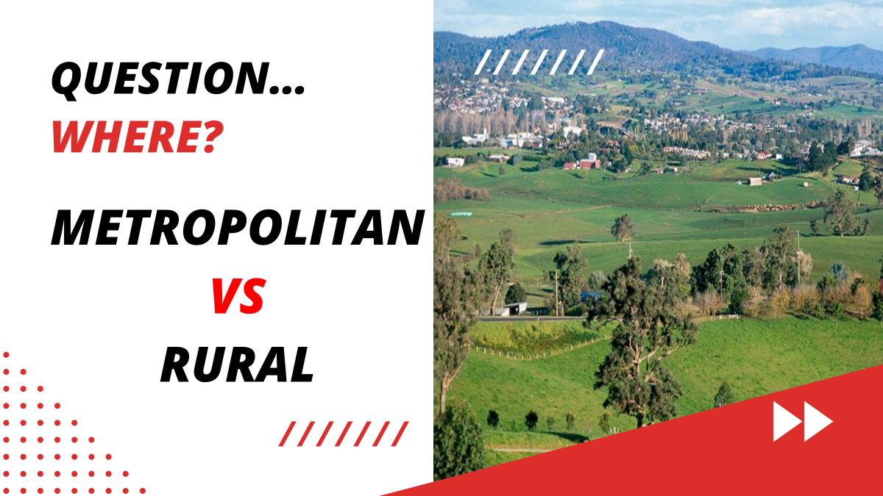

Slide 4
Question…..Where?
Metropolitan VS Rural
-For our project we decided to focus on the
metropolitan and rural communities
Hypothesis
-We believe people in urban areas are
more active therefore we assume that they are more
likely to bike and walk. We also predict there will be higher
Technology use in rural areas.

Slide 5
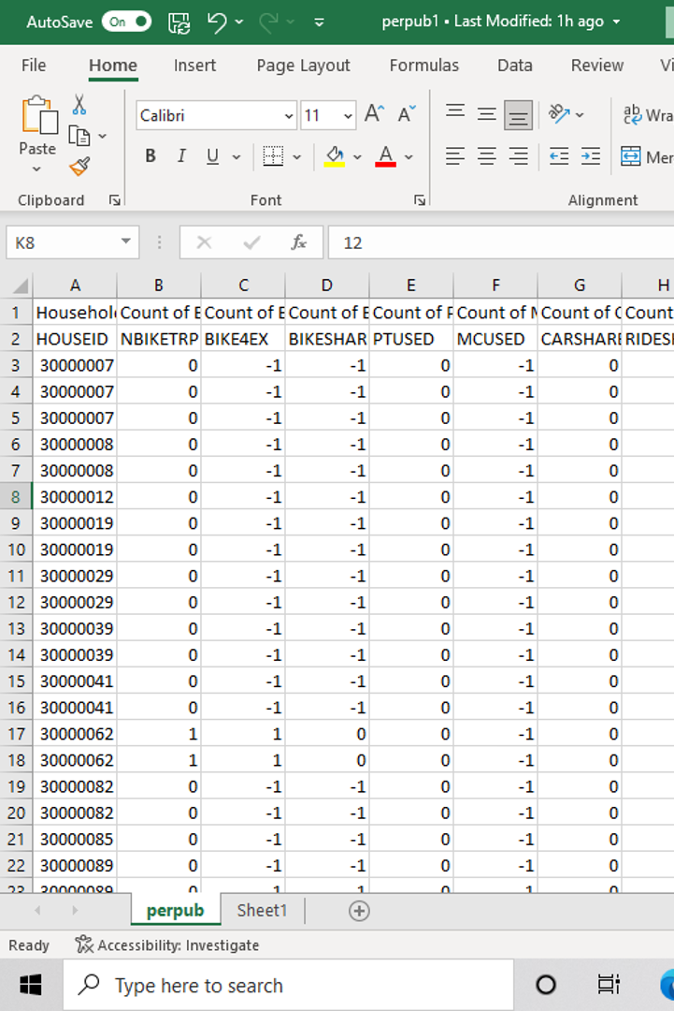
Intro
The first challenge we faced was the vast amount of data
We had to work with
We started cleaning through the data and
condensing it to make easier to understand.
We then established the data we wanted to focus on
And started determining the different relationships
between the data

Slide 6
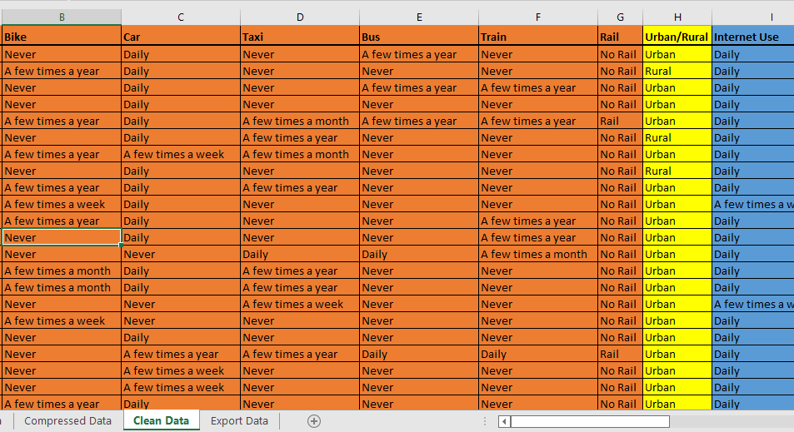
Step 1 Data Prep : ETL Pipeline
To get the data ready for analysis, we first needed to put the data through a series of transformations.
Input Excel Sequence:
Raw
Compressed
Clean
Export
Python Sequence:
Import
Split by Urban/Rural
Sampling & Rebalance
Export to 'Output.xlsx'
Output Excel Sequence
Verify Output from Jupyter Notebook ->
Combine Rural & Urban Samples as 'Stacked' Sheet
Saved file as 'Data Prep Output'

Slide 7
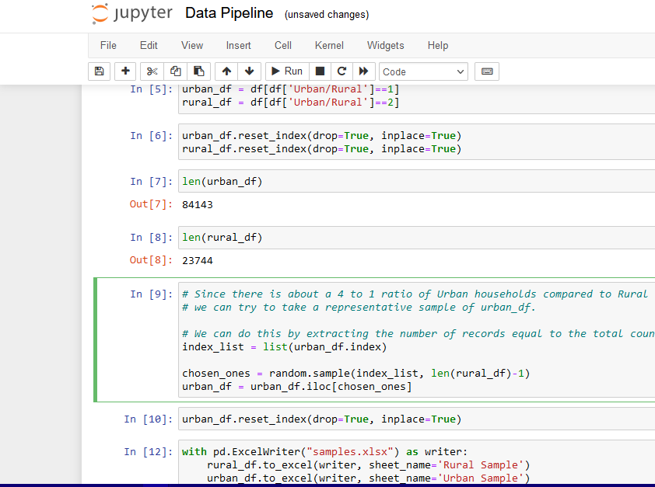
Step 1 Data Prep : ETL Pipeline
To get the data ready for analysis, we first needed to put the data through a series of transformations.
Input Excel Sequence:
Raw
Compressed
Clean
Export
Python Sequence:
Import
Split by Urban/Rural
Sampling & Rebalance
Export to 'Output.xlsx'
Output Excel Sequence
Verify Output from Jupyter Notebook ->
Combine Rural & Urban Samples as 'Stacked' Sheet
Saved file as 'Data Prep Output'

Slide 8
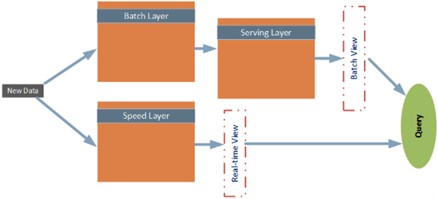
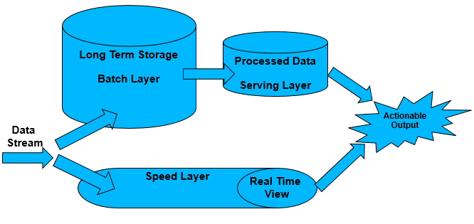
Lambda Architecture
After cleaning the data, we used Tableau & Excel to further investigate our Hypothesis in Step 2: Data Analysis.

Slide 9
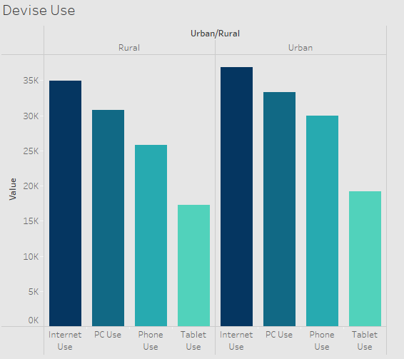
Step 2 Analysis
Our team used Tableau
Devise us in Metropolitan area vs rural
Hypothesis was that rural would be much higher
Analysis shows we were incorrect
Urban although close still higher

Slide 10
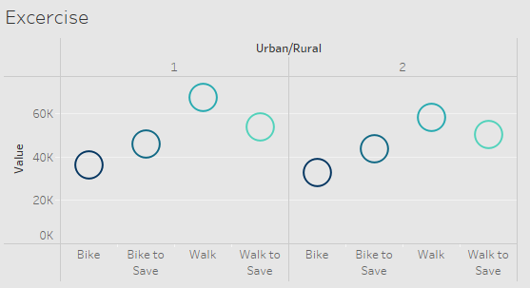
Step 2 Analysis
Compared Urban vs Rural Activity
Similar pattern
Urban still higher score with activity

Slide 11
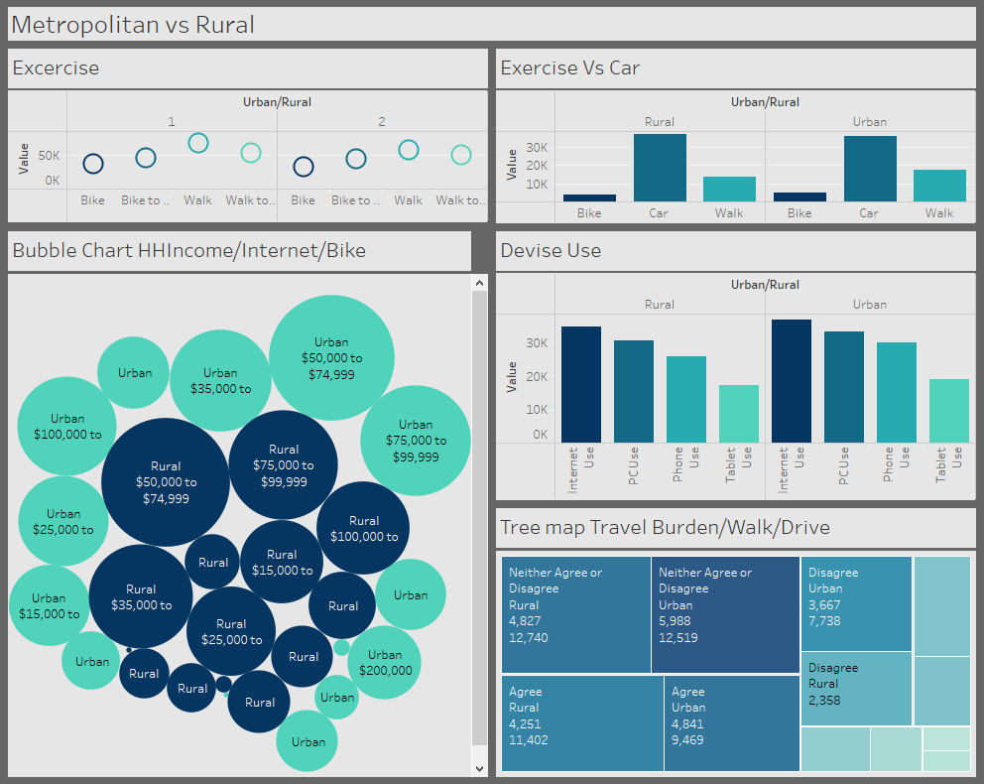
Dashboard

Slide 12
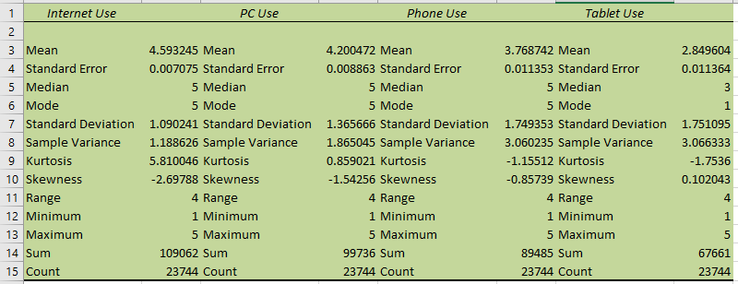
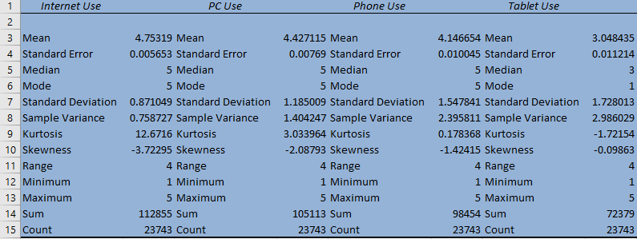
Step 3 Results/Statistical Findings
Summary Statistics of Internet Use
Comparison Between Rural (Green) & Urban (Blue) Households. Negative Skewness
Results: Urban Households on Average use more internet than their Rural counterparts.

Slide 13
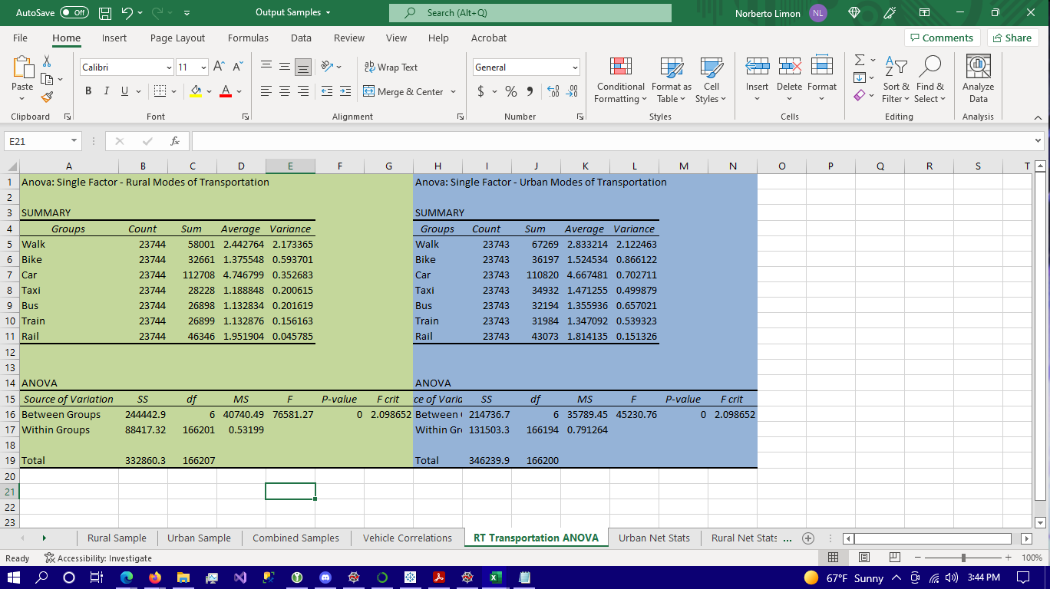
Step 3 Results/Statistical Findings
ANOVA of Transportation Methods by Region
Comparison Between Rural (Green) & Urban (Blue) Households.
Greater use of most forms of transportation in Urban areas. Car & Rail Outliers.
Urban Households on Average walk & Bike more than their Rural counterparts.

Slide 14
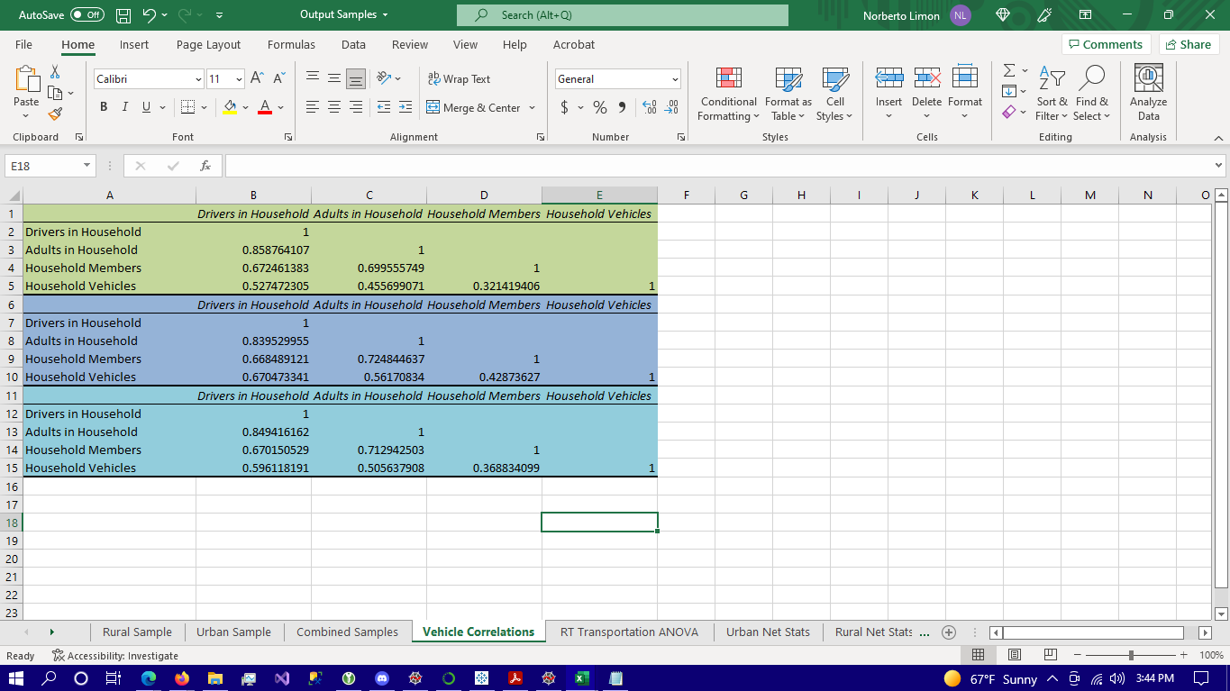
Step 3 Results/Statistical Findings
Pairwise Correlation of Vehicle Availability Variables
Comparison Between Rural (Green) & Urban (Blue) Households.
Higher Person to Vehicle Ratio in Urban Areas.
Higher Ratio of Non-drivers Rural regions by comparison. Nevertheless, greater usage of cars as transportation in Rural areas than Urban as demonstrated in previous slide
Less Options? Partially supports our initial hypothesis.

Slide 15
Step 3 Results/Conclusion
-Finally, we can conclude there is a slightly higher number of
people walking and biking in urban areas. While in rural
Areas, we can see that there is a slightly higher emphasis on
vehicle usage which supported the first part of our hypothesis.
-As far as technology usage (internet/pc/phone/tablet)
urban areas have a slightly higher usage of technology
Compared to rural which did not support the second part of
Our hypothesis.

Slide 16


